Slide 1
Visualizing Housing Market Trends: An Analysis Of Sale Prices And Features Using Tableau
SlideMake.com

Slide 2

Introduction to Housing Market Visualization
This presentation explores how Tableau can be used to analyze housing market trends effectively.
Visualizing sale prices and property features helps identify patterns and insights for stakeholders.
The goal is to demonstrate the power of data visualization in making informed real estate decisions.
1
Notes:
Image source: https://blog.ziba-property.com

Slide 3

Importance of Analyzing Housing Market Trends
Understanding market trends assists buyers, sellers, and investors in making strategic choices.
Trends in sale prices reveal shifts in demand, affordability, and economic health.
Visualization simplifies complex data, making it accessible and actionable for diverse audiences.
2
Notes:
Image source: https://as1.ftcdn.net

Slide 4
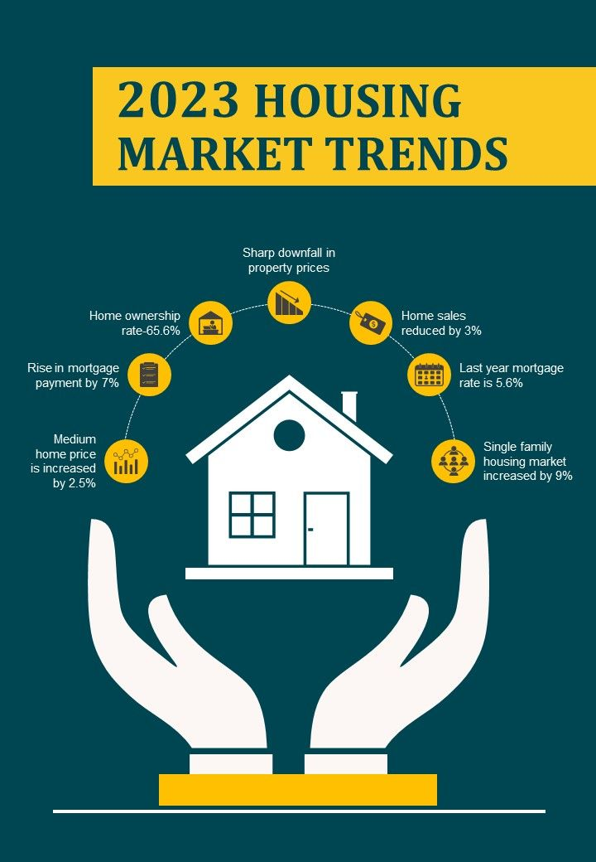
Data Collection and Preparation
Data was sourced from public real estate records and includes sale prices, property features, and locations.
Cleaning involved removing duplicates and handling missing values to ensure accuracy.
The dataset was structured to facilitate effective visualization and analysis in Tableau.
3
Notes:
Image source: https://www.slideteam.net

Slide 5
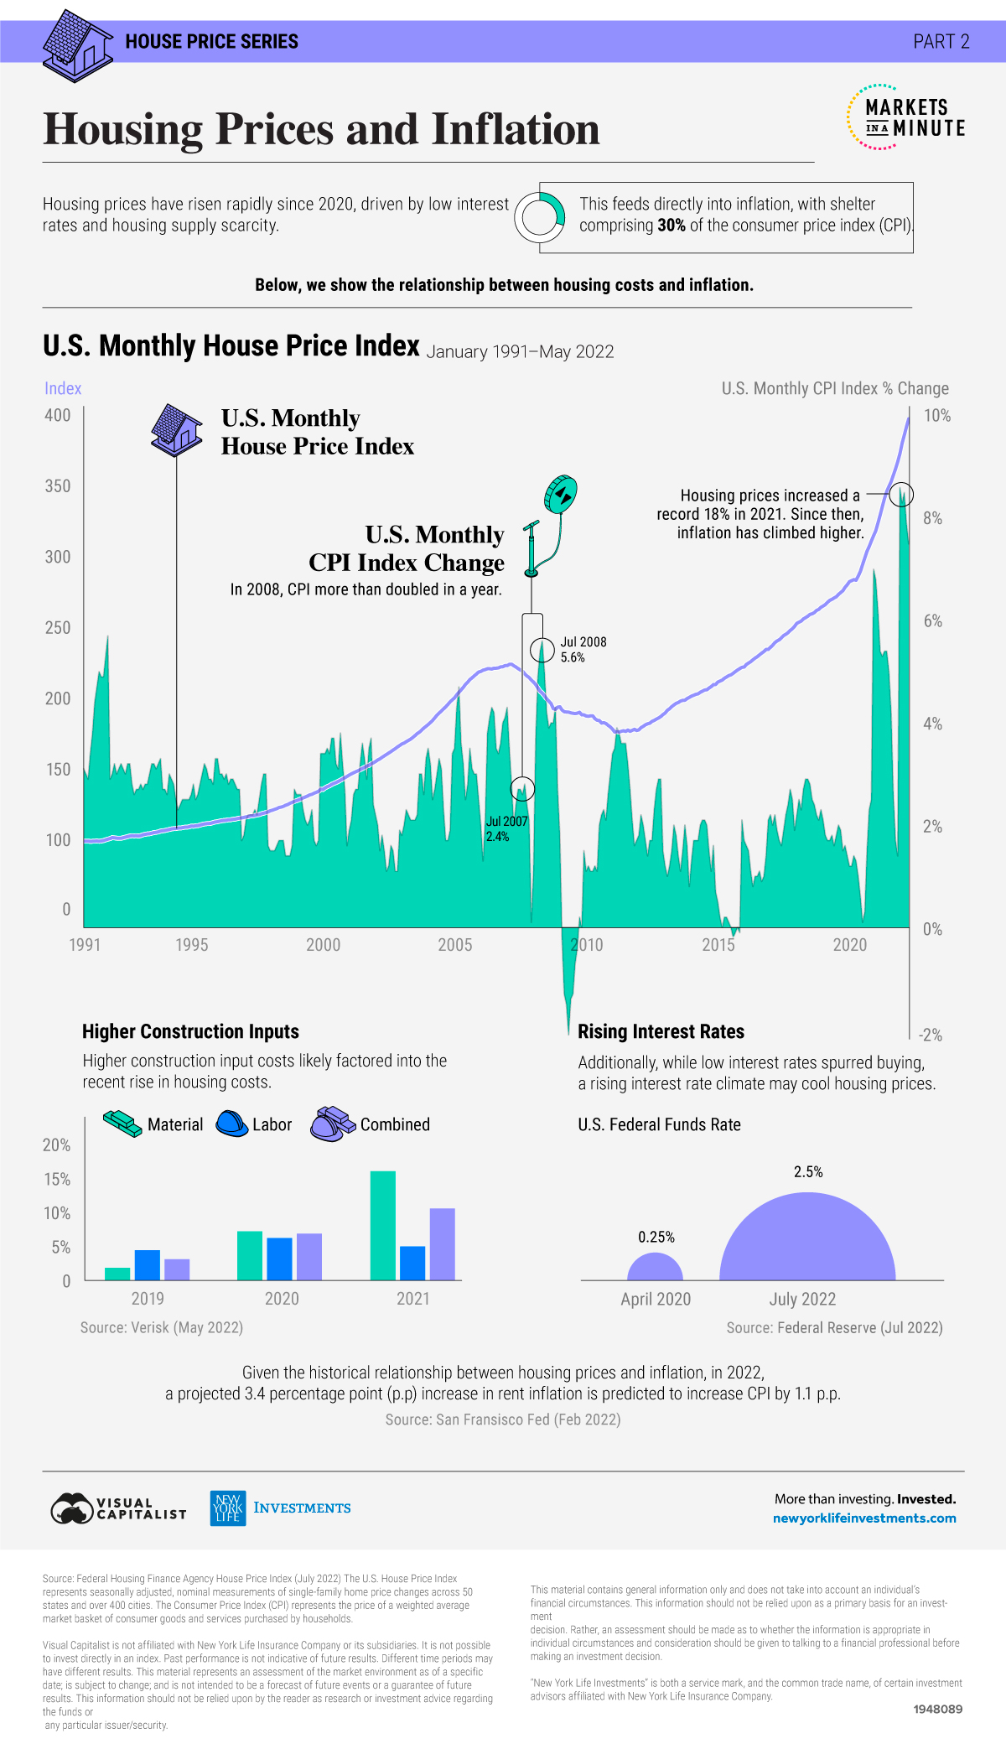
Key Features Analyzed in the Dataset
Property features such as size, number of bedrooms, and bathrooms were examined.
Location data included neighborhoods, zip codes, and proximity to amenities.
Sale prices were analyzed in relation to these features to identify significant correlations.
4
Notes:
Image source: https://advisor.visualcapitalist.com

Slide 6
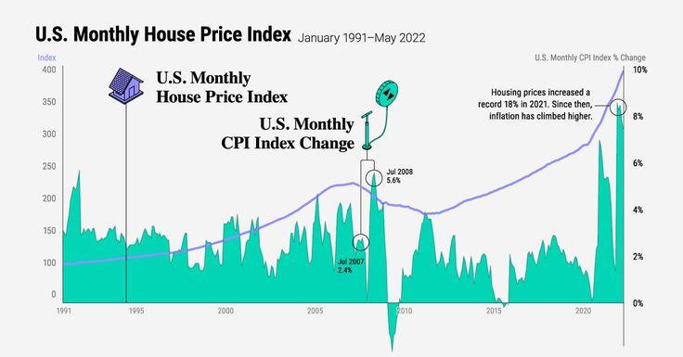
Visualizing Sale Price Distribution
A histogram was used to display the distribution of sale prices across different ranges.
This visualization helps identify price clusters and outliers in the market.
It provides an overview of the overall market affordability and segmentation.
5
Notes:
Image source: https://i.pinimg.com

Slide 7

Geographic Trends in Housing Prices
A heat map visualized sale prices across neighborhoods to reveal spatial patterns.
Clusters of higher or lower prices indicate areas of increased demand or affordability.
Geographic visualization assists in strategic location-based decision-making.
6
Notes:
Image source: https://advisor.visualcapitalist.com

Slide 8
Trends Over Time in Sale Prices
Line charts tracked median sale prices over specific time periods to identify upward or downward trends.
Seasonal fluctuations and market cycles became apparent through temporal analysis.
Time-based visualizations support forecasting and planning for market participants.
7
Notes:
Image source: https://as1.ftcdn.net

Slide 9
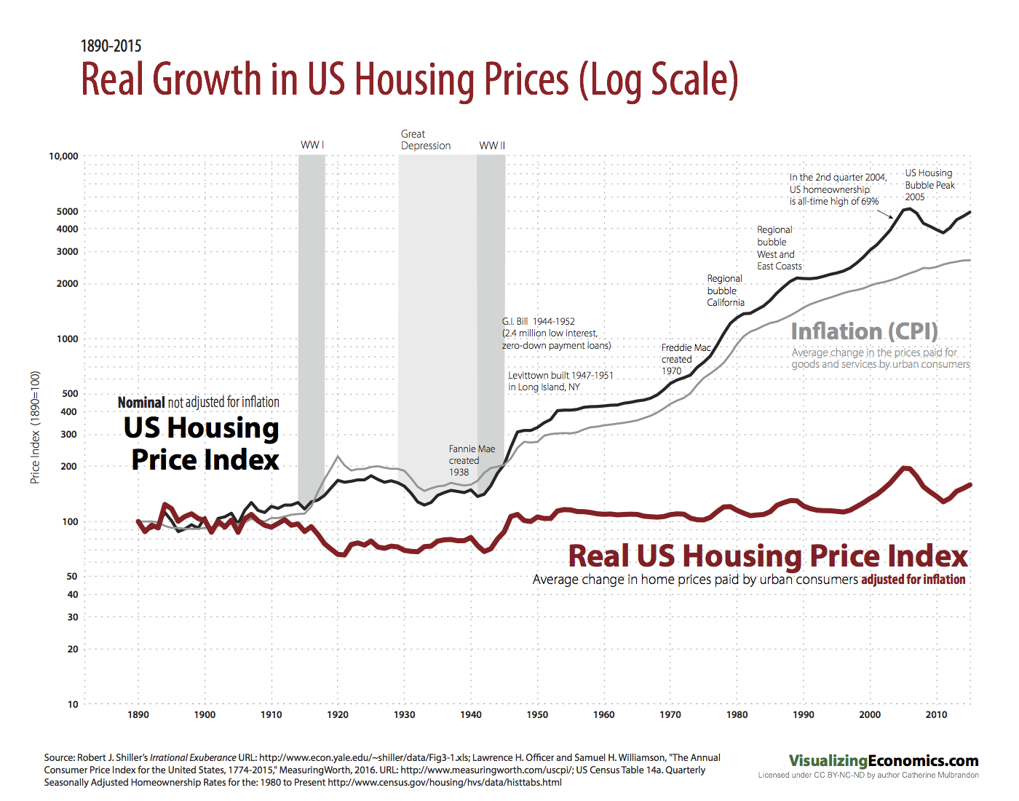
Analyzing Property Features and Pricing
Scatter plots illustrated relationships between property features (e.g., size, bedrooms) and sale prices.
Regression analysis highlighted which features significantly influence property value.
These insights help sellers optimize property features for better pricing.
8
Notes:
Image source: https://images.squarespace-cdn.com

Slide 10
Actionable Insights and Conclusions
Market clustering suggests targeting high-growth neighborhoods for investment.
Property features like size and location significantly impact sale prices.
Visualization tools like Tableau empower stakeholders to make data-driven real estate decisions.
9
Notes:
Image source: https://www.slideteam.net

Slide 11
References
Tableau Software. (2023). Data Visualization Best Practices.
U.S. Census Bureau. (2023). Housing Data and Reports.
Real Estate Data Providers. (2023). Public Property Records and Sale Data.
10

